Slide 1
Welcome Everyone to Neural Networks
Instructor
Dr. Mohammad Rashedur Rahman,
Professor, ECE Dept., North South University

Slide 2
About Instructor
Instructor: Mohammad Rashedur Rahman, Professor, ECE Dept.,
Ph.D. (Canada), M.Sc. (Canada), B.Sc. in Engg. (BUET, CSE).
Office: SAC 933
Office Hours: ST: 1:00-2:30 PM, Wednesday : 6:00-7:00 PM

Slide 3

My Papers in DBLP

Slide 4

My Papers in DBLP (Cont..)

Slide 5
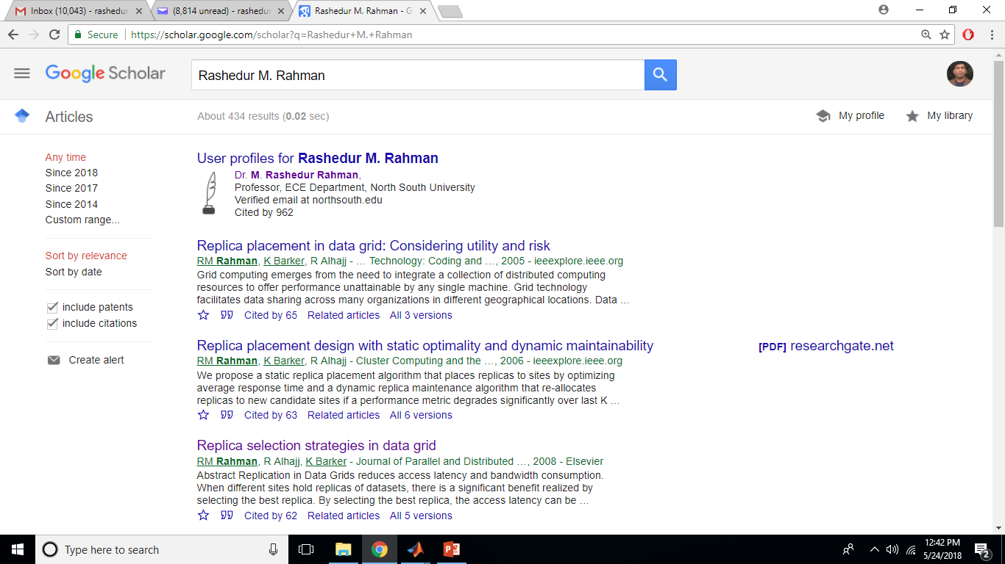
Google Scholar and Myself

Slide 6
Mark Distribution
Class Attendance : 10%
Midterm : 20%
Final (Comprehensive): 35%
Term Project (35%) [Group of Maximum 6]
Project proposal and presentation of project proposal (): (4-5 slides) 5%
Paper Presentation based on a paper related to your project (): (15-20 slides) 8% (July 11, 2018)
Project Advancement Presentation () (10-15 slides): with an intermediate report : 4% (August 26/28, 2018)
A review from course instructor will be mailed within a week, you have to prepare final report with the modifications instructed by course instructor
Term Paper Presentation with program or software developed(): 18% (Fail to present for any reason will account for term project mark 0)
Any copy paste of materials from books, other research papers are considered to be unethical and academic dishonesty that could lead to project mark to zero as well F to course and in the worst case opt out the student from NSU. Sep 10, 2018 (Firm and Strict Deadline)

Slide 7
Text Book
1. Fundamentals of Neural Networks
by Laurence Fausset
2. Neural Network Design (Who Designed the Matlab NNToolbox)
by Martin T. Hagan, Howard B. Demuth, Mark Hudson Beale,
Orlando De Jesús.
Other good books
3. Neural Network and Training Machines, Simon Haykin, 3rd. Edition
4. Neural Networks: A Comprehensive Introduction, Simon Haykin, 2nd Edition
5. Neural Networks for Pattern Recognition: Christopher M. Bishop

Slide 8
Artificial Neural Network (ANN)
An artificial neural network is an information-processing system that has certain performance characteristics in common with biological neural networks.
Artificial neural networks have been developed as generalizations of mathematical models of human cognition or neural biology, based on the assumptions that:
Information processing occurs at many simple elements called neurons.
Signals are passed between neurons over connection links.
Each connection link has an associated weight, which, in a typical neural net,
multiplies the signal transmitted.
4. Each neuron applies an activation function (usually nonlinear) to its net input (sum of weighted input signals) to determine its output signal.

Slide 9
Characterization of ANN
A neural network is characterized by
its pattern of connections between the neurons (called its architecture),
(2) its method of determining the weights on the connections (called its training, or learning, algorithm), and
(3) its activation function

Slide 10
Use of ANN
A neural net consists of a large number of simple processing elements called neurons, units, cells, or nodes.
Each neuron is connected to other neurons by means of directed communication links, each with an associated weight. The weights represent information being used by the net to solve a problem.
Neural nets can be applied to a wide variety of problems, such as
storing and recalling data or patterns,
classifying patterns, performing general mappings from input patterns to output patterns,
grouping similar patterns, or
finding solutions to constrained optimization problems.

Slide 11
Example of a Simple Neuron

Slide 12
Example of a Simple Neural Network

Slide 13
Basic Components of Biological Neurons
1. The majority of neurons encode their activations or outputs as a series of brief electrical pulses (i.e. spikes or action potentials).
2. The neuron’s cell body (soma) processes the incoming activations and converts
them into output activations.
3. The neuron’s nucleus contains the genetic material in the form of DNA. This exists in most types of cells, not just neurons.
4. Dendrites are fibres which emanate from the cell body and provide the receptive
zones that receive activation from other neurons.
5. Axons are fibres acting as transmission lines that send activation to other neurons.
6. The junctions that allow signal transmission between the axons and dendrites are called synapses. The process of transmission is by diffusion of chemicals called neurotransmitters across the synaptic cleft.

Slide 14
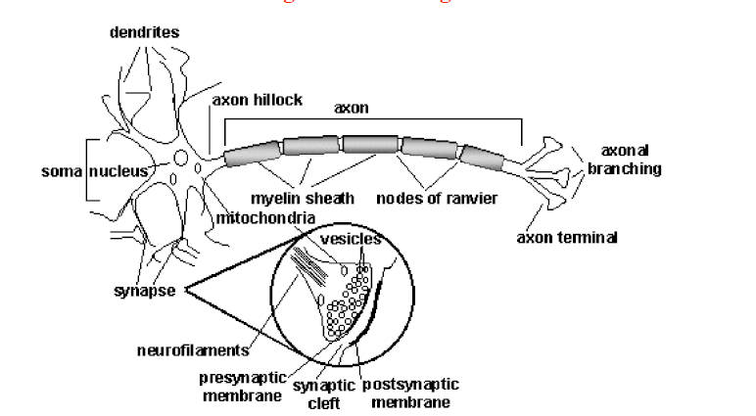
Schematic Diagram of a Biological Neuron

Slide 15
Neural Signal Processing
The key components of neural signal processing are:
Signals from connected neurons are collected by the dendrites.
2. The cells body (soma) sums the incoming signals (spatially and temporally).
3. When sufficient input is received (i.e., a threshold is exceeded), the neuron generates an action potential or ‘spike’ (i.e., it ‘fires’).
4. That action potential is transmitted along the axon to other neurons, or to structures outside the nervous systems (e.g., muscles).
5. If sufficient input is not received (i.e. the threshold is not exceeded), the inputs quickly decay and no action potential is generated.
6. Timing is clearly important – input signals must arrive together, strong inputs will generate more action potentials per unit time.

Slide 16
History of ANN
1943 McCulloch and Pitts proposed the McCulloch-Pitts neuron model
1949 Hebb published his book The Organization of Behavior, in which the Hebbian learning rule was proposed.
1958 Rosenblatt introduced the simple single layer networks now called Perceptrons.
1969 Minsky and Papert’s book Perceptrons demonstrated the limitation of single layer perceptrons, and almost the whole field went into hibernation.
1982 Hopfield published a series of papers on Hopfield networks.
1982 Kohonen developed the Self-Organising Maps that now bear his name.
1986 The Back-Propagation learning algorithm for Multi-Layer Perceptrons was rediscovered
and the whole field took off again.
1990s The sub-field of Radial Basis Function Networks was developed.
2000s The power of Neural Network Ensembles, and Deep Learning becomes apparent

